Slide 1
TEACHING MATERIALS HEART FROM AUSCHWITZ

Slide 2
THE HISTORY OF THE “HEART FROM AUSCHWITZ”
Her name is Fania. The F on the front of the heart is the first letter of her name.
During the war, Fania was in Poland. She was a prisoner at the Auschwitz camp and was forced to work in a munitions factory.
December 12, 1944, is Fania’s birthday. She is 20 years old. In the munitions factory, Fania has a friend called Zlatka.
Zlatka wants to give Fania a gift for her birthday. She decides to make a heart which will contain the signatures of many women who work in the munitions factory.
Zlatka makes the heart and it is very difficult to find the things she needs to make it with. Scissors, paper, material and pencils are very rare, forbidden objects.
Once the heart is made, she puts a note in the heart and then gets about 20 women to sign it. These women, all prisoners in Auschwitz, come from different countries. They write in the heart in Polish, German, French and Hebrew. In the heart there are messages of friendship, words of hope, birthday wishes and signatures. Then they give the heart to Fania.
In January 1945, Auschwitz is evacuated. Fania and her comrades are forced to walk towards Germany. This event is called the “Death March”. Fania manages to keep the heart hidden under her arm for the entire journey.
After walking for three days, Fania and some of the other workers from the munitions factory are deported by train to Ravensbrück, which is a concentration camp for women. The last message is written in the heart by a young woman on January 26, 1945, at Ravensbrück.
Fania and Zlatka are both survivors of the Holocaust. Fania’s favourite inscription in the heart is “Freedom, Freedom, Freedom.” Fania donated the heart to the Montreal Holocaust Museum in 1988. It is an exceptional object in the museum: It is one of the rare objects known to have been created by prisoners in Auschwitz.
In 1998, Zlatka, like many other Holocaust survivors, told her life story in Yiddish in front of a camera in Montreal. In this recording, she tells how she had the idea to make the heart and how she proceeded to make it. She says: “We were 20 (women); that is why I imagined 20 layers.” In fact there are 12 women’s signatures in the heart.
The story of the heart continues. In 2008, a documentary was made about the heart. The directors Luc Cyr and Carl Leblanc travelled all over the world to find the women who signed the heart. When the documentary was being made, Fania saw the Heart from Auschwitz again at the Montreal Holocaust Museum. On this occasion, students from Lambert-Closse School in Montreal, who did The Heart From Auschwitz activity, gave her a heart for her 84th birthday.
Zlatka Pitluk recounted her life story and her experience of the Holocaust in front of a video camera on September 16, 1998. Certain survivors choose to do this in order to transmit their memories to young people.
Fania now lives in Toronto. She was born on December 12, 1924.
Zlatka lived in Buenos Aires until she passed in 2018. She was born on September 24, 1924.
Fania Fainer, December 10, 2008, at the Montreal Holocaust Museum Here she is in front of the glass cabinet in which the Heart from Auschwitz is displayed.
© Montreal Holocaust Museum

Slide 3
© Montreal Holocaust Museum

Slide 4
© Montreal Holocaust Museum

Slide 5
© Montreal Holocaust Museum

Slide 6
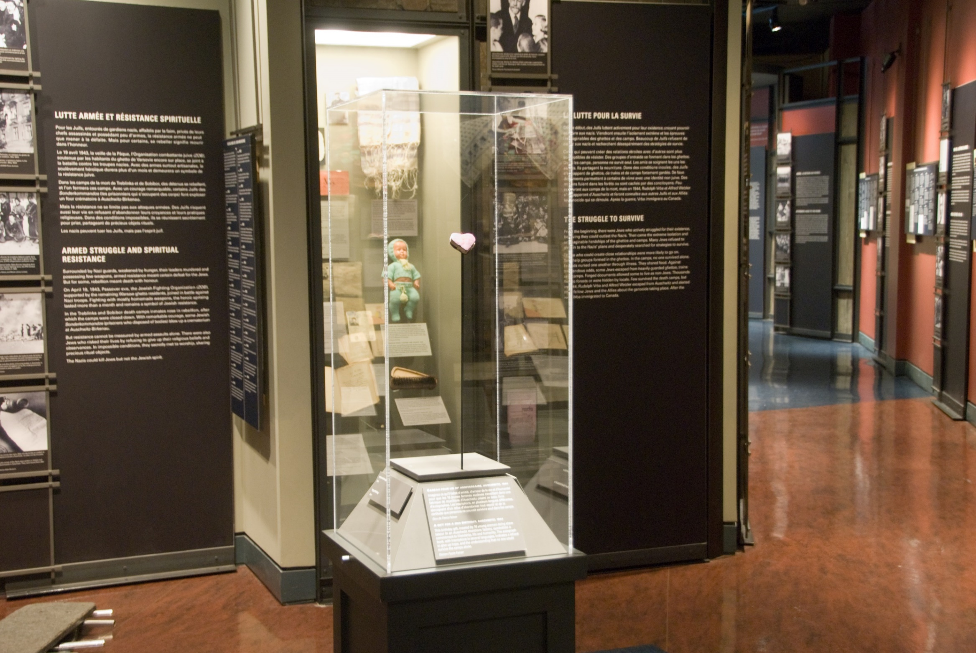
© Montreal Holocaust Museum

Slide 7
© Montreal Holocaust Museum

Slide 8
© Montreal Holocaust Museum

Slide 9
© Montreal Holocaust Museum

Slide 10
© Montreal Holocaust Museum

Slide 11
© Montreal Holocaust Museum

Slide 12
© Montreal Holocaust Museum

Slide 13
© Montreal Holocaust Museum

Slide 14
© Montreal Holocaust Museum

Slide 15
© Montreal Holocaust Museum

Slide 16
© Montreal Holocaust Museum

Slide 17
© Montreal Holocaust Museum

Slide 18
© Montreal Holocaust Museum

Slide 19
© Montreal Holocaust Museum

Slide 20
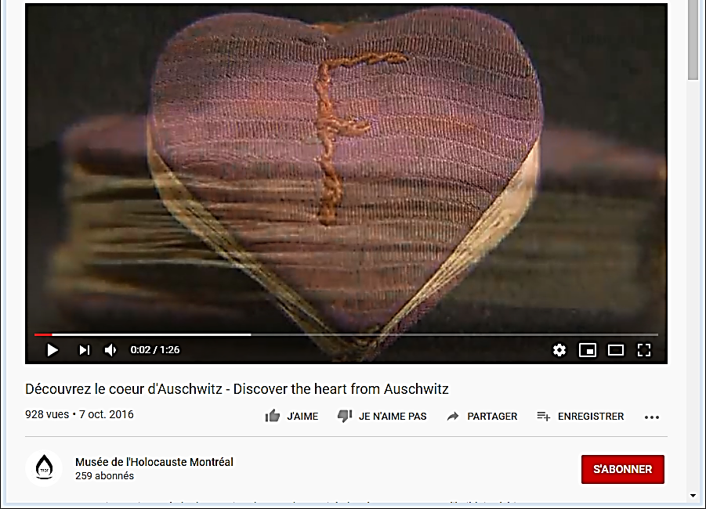
https://www.youtube.com/watch?v=WnIoy297LVI&feature=youtu.be
© Montreal Holocaust Museum

Slide 21
https://www.youtube.com/watch?v=SySpOO-E43o&feature=youtu.be
© Montreal Holocaust Museum

Slide 22
https://www.youtube.com/watch?v=h16uy3JfkRI&feature=emb_logo
© Montreal Holocaust Museum

Slide 23
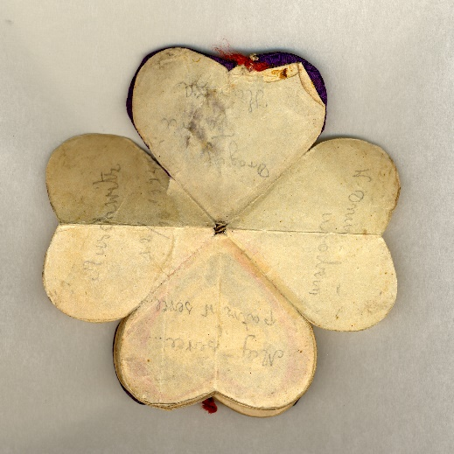
Hanka
Original language | Translation
Polish | In the day of your birthday Have a heart, Look into a heart Auschwitz 12/XII/1944 To my dear Fanni Hanka
© Montreal Holocaust Museum

Slide 24
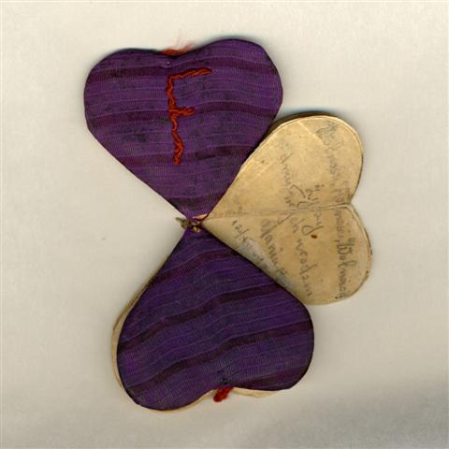
Mania
Original language | Translation
Polish | Freedom, Freedom, Freedom Wishing on the day of your birthday Mania M(…) 12/XII/1944
© Montreal Holocaust Museum

Slide 25
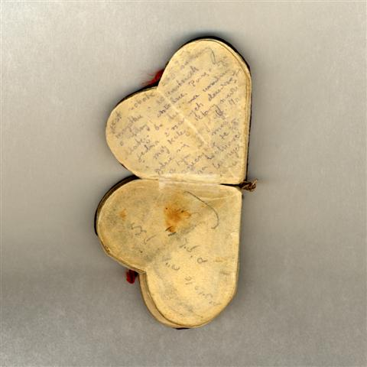
Not signed / Mazal
Original language | Translation
Polish | It’s Saturday 26.I.45. Everything (…) Ravensbrück. I am writing here, on this paper because there is no more birthdays. One our girls and my boyfriend, which I don’t know where they are, I can only surmise that they are free by now
Hebrew | May your life be long and sweet Mazal
© Montreal Holocaust Museum

Slide 26
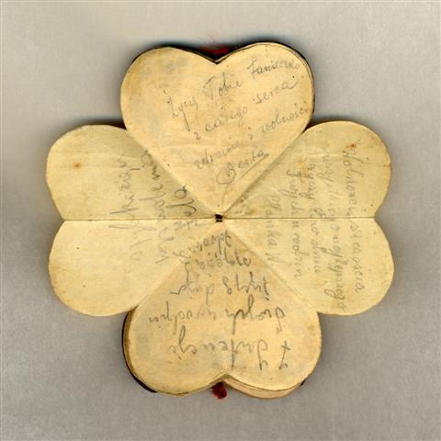
Hanka W / Fela / Berta
Original language | Translation
Polish | Freedom and luck All the best wishes on the day of your birthday Hanka W.
Polish | In the occasion of your birthday We wish you lots of luck and health I wish you a fast freedom Fela
Polish | Faniecka From the bottom of my heart Health and freedom, Berta
© Montreal Holocaust Museum

Slide 27
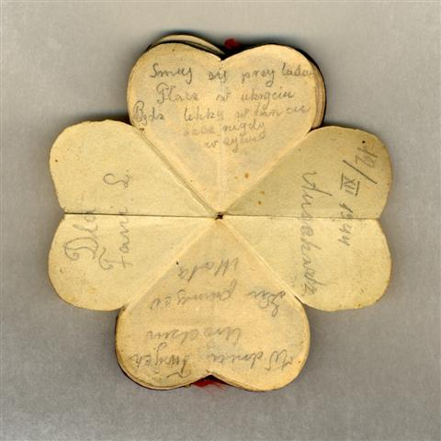
Mala
Original language | Translation
Polish | For Fani L. Laugh among the people, cry in hiding Be light in dance, but never in life In the day of your birthday, to remember Mala 12/XII/1944 Auschwitz
© Montreal Holocaust Museum

Slide 28
Ruth
Original language | Translation
German | Fani Learn all about human beings, because they are changing People who are calling you a friend today will be talking against you tomorrow Blue eyes, red mouth Dear Fani, stay healthy Auschwitz On the 12.12.1944 I wish you the best dear fani, Ruth
© Montreal Holocaust Museum

Slide 29
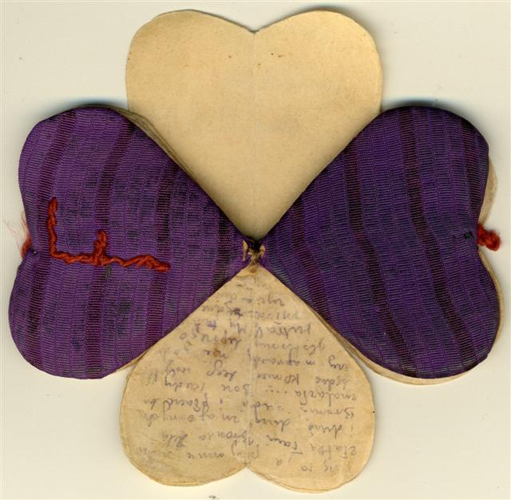
Non signed
Original language | Translation
Polish | Near me are Zlatka, Fania, Bronia, Hela and a lot of people which I know. Bronia is sitting and she is crying. She is freezing. My dear God, when is this going to be the end of it all? Really, will we ever have a better tomorrow? We are so young and have so much life in front of us
© Montreal Holocaust Museum

Slide 30
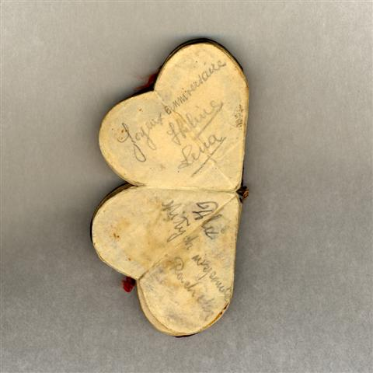
Hélène, Lena / Rachela
Original language | Translation
French | Happy Birthday Helene Lena
Polish | For pleasant memories Rachela
© Montreal Holocaust Museum

Slide 31
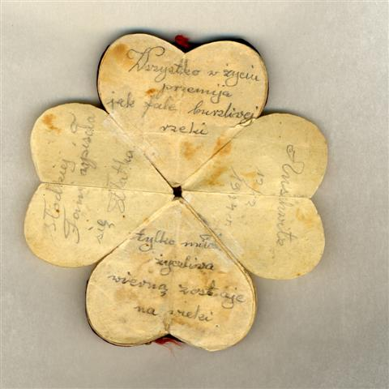
Zlatka
Original language | Translation
Polish | Everything in life passes by like a wave over a rushing river Only true love stays faithful forever Love To sweet Fani Written by Zlatka Auschwitz 12/XII/1944
© Montreal Holocaust Museum

Slide 32
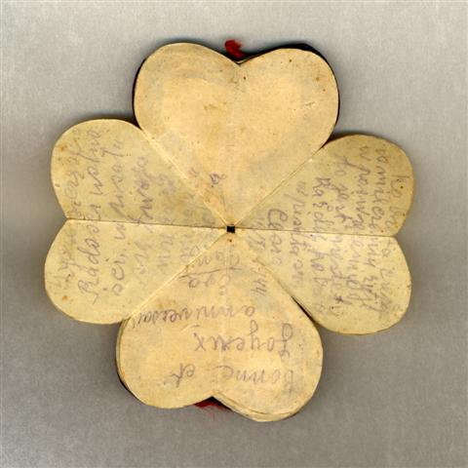
Eva Pany / Bronia / Cesia
Original language | Translation
French | Good and happy birthday Eva Pany
Polish | I wish you luck, happiness, freedom, written into your own (…) Bronia
Polish | Virtue is (…) keep quiet and that’s our sacrifice This is unfortunately everybody’s fate Signed Cesia 12/XII/1944
© Montreal Holocaust Museum

Slide 33
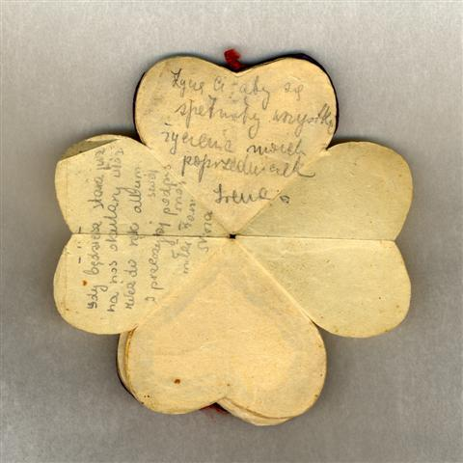
Irena / Mina
Original language | Translation
Polish | I wish that all your wishes should be fulfilled (As well as our predecessors) Irena
Polish | When you get old, put your glasses on your nose, take this album in your hand and read my signature again, my loved Fani, Mina
© Montreal Holocaust Museum

Slide 34
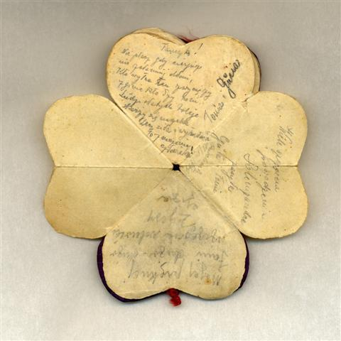
Tonia & Gusia / Guta & Tonia / Giza
Original language | Translation
Polish | Faniezka! Don’t cry when you are suffering, don’t let down your hand The one that is strong will win, the one who is down will perish! Tonia and Gŭsia
Polish | My hearty wishes and achievements Sent by Guta and Tonia 11/XII
Polish | My beautiful Fania A lot of luck and freedom Wishes Giza
Gŭsia is the same name than Guta. It’s the same woman.
© Montreal Holocaust Museum

Slide 35
Interpreting an artefact
Interpreting a video testimony
ARTEFACT ANALYSIS SHEET
Observe the artefact and try to answer the following questions. Explain your answers:
Describe the object: Type, shape, material, colour, etc.
What condition is it in?
When does it date from?
Is it a written document? If so, read the document about primary sources.
Is there an inscription on it? In what language?
What can be said about the object’s owner?
What does it teach us about the people who used it or who could have been affected by it?
How big do you think this object is?
Who do you think made this object?
Where do you think this object came from? Where was it used?
What do you think this object was used for?
What does this artefact teach us about the Holocaust? About World War II?
Do objects like this exist today?
VIDEO TESTIMONY ANALYSIS SHEET
You are going to watch a video clip taken from the testimony of a Holocaust survivor or witness.
Instructions
Before viewing the clip, read the person’s biography.
Answer the following questions, based on what the person being interviewed had to say. (Some questions may not apply to your clip):
Questions
Name of the person interviewed:
What event is the person talking about?
3. When and where did this event take place?
How old was the person at that time?
How did the person react? What did he/she do?
How did he/she feel?
7. What impact or consequences did the event have on him/her?
How did the other people he/she mentions react? (Did they help, collaborate with the Germans, etc.)
Why do you think they did what they did? Are you surprised? Why?
© Montreal Holocaust Museum, 2018
© Montreal Holocaust Museum, 2018

Slide 36
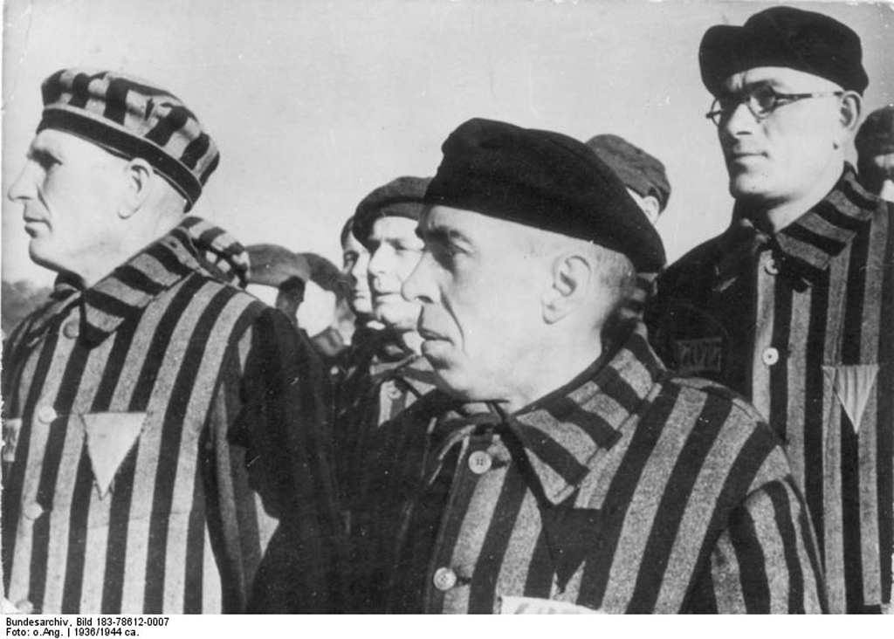
Yellow and red star prisoner’s badge worn in concentration camp to identify a Jewish political opponent. Germany, 1939
Prisoners of the Sachsenhausen concentration camp stand in line for the roll call. Germany, 1936.
Source: Bundesarchiv, Bild 183-78612-0007/CC-BY-SA
© Montreal Holocaust Museum

Slide 37
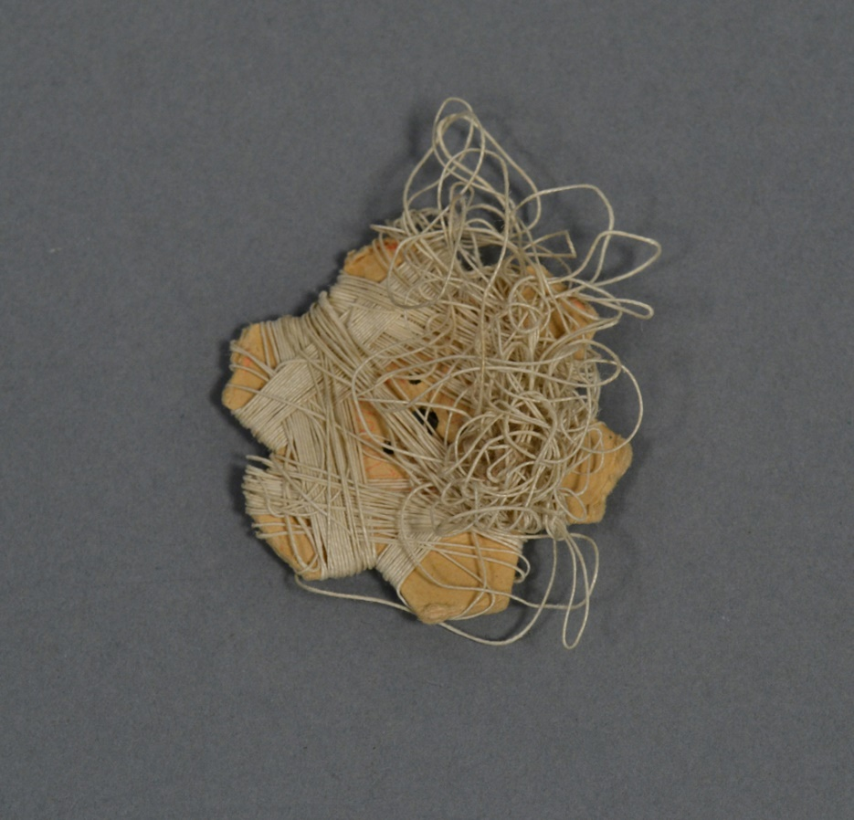
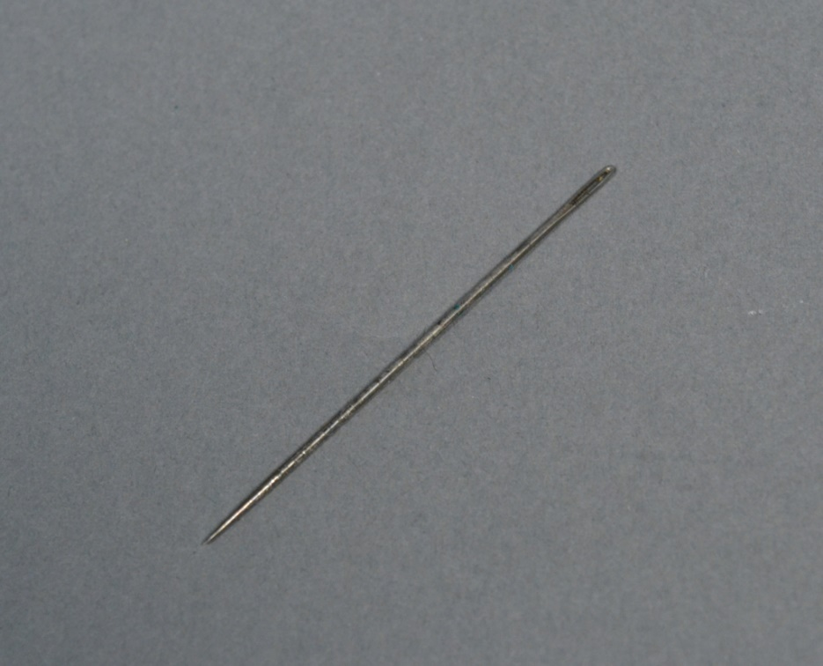
Family photograph taken in Kovno, Lithuania, 1938. Rosa Pliskin (1898-1986) is the third person from the right, in the second row. Her husband Mordechai Pliskin, who was killed in concentration camp Dachau, is in the centre.
Sewing kit kept in concentration camp by Rosa Pliskin. Poland, circa 1942.
© Montreal Holocaust Museum

Slide 38
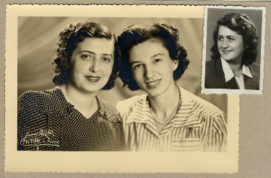
Portrait of Sonia Aronowicz with her sister-in-law Miriam Rykles and her friend Minya Varecklhad (in top right photo). Poland, circa 1946.
Source: Family collection.
Dress prisoner uniform worn by Sonia Aronowicz. Poland, 1943-1945.
Between 1943 and 1945, Sonia was interned in many concentration camps in Latvia and Poland. She survived a death march and was eventually liberated by Soviet soldiers in Poland.
© Montreal Holocaust Museum

